Slide 1
WebGL Gasket
Project # 2
Jeff Registre

Slide 2
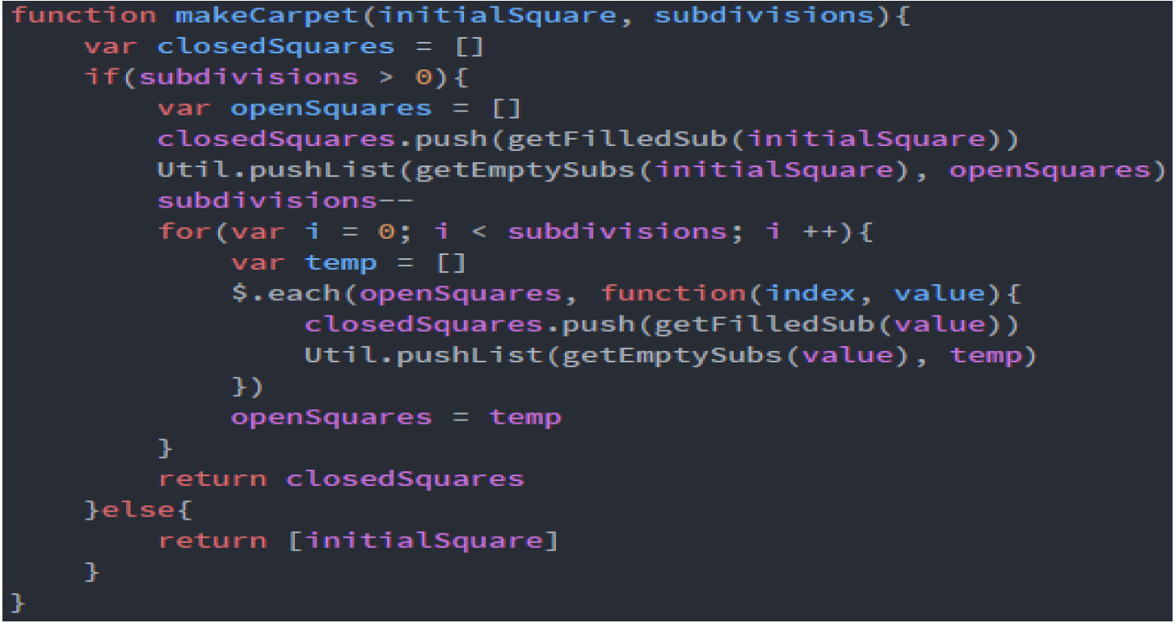

Slide 3
Control flow (my flow is fire)

Slide 4
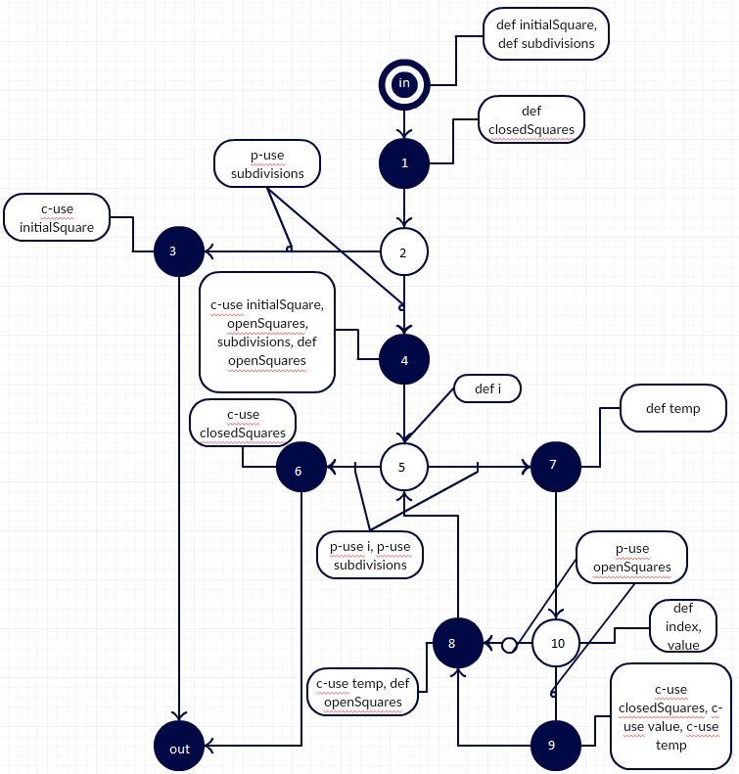

Slide 5

E lance Classes and Test Cases

Slide 6
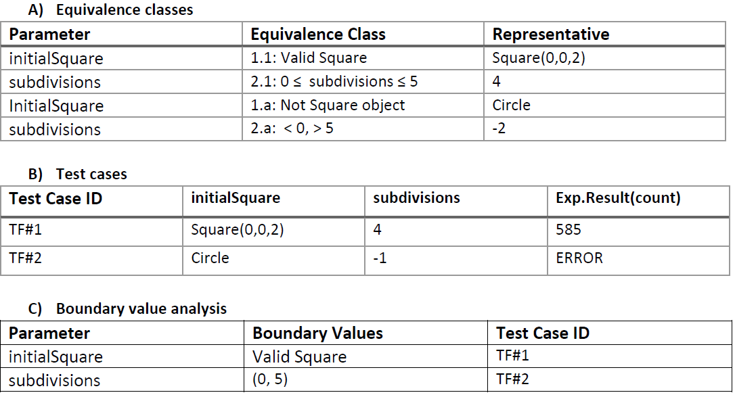

Slide 7
DCU and DPU sets
Node(n) | Def(n) | C-use(n)
In | {initialSquare, subdivisions | { Ø}
1 | {closedSquares} | { Ø}
2 | { Ø} | { Ø}
3 | { Ø} | {initialSquare}
4 | {openSquares} | {initialSquare,subdivisinos, openSquares}
5 | { i} | { Ø}
6 | { Ø} | {closedSquares}
7 | {temp} | { Ø}
8 | {openSquares} | {temp}
9 | { Ø} | {closedSquares,value,temp}
10 | {index,value} | { Ø}
out | { Ø} | { Ø}
Edge(n,m) | p-use(n,m)
(3,4) | {subdivisions}
(6,7) | {i, subdivisions}
(8,9) | {openSquares}

Slide 8
Definition free path
Node n | Variable x | DCU(x,n) | DPU(x,n)
In | initialSquare | {3,4} | { Ø}
In | subdivisions | {4} | {(3,4)}
4 | subdivisions | {4} | {(3,4)}
1 | closedSquares | {6,9} | { Ø}
4 | openSquares | {4} | {(8,9)}
8 | openSquares | {4} | {(8,9)}
5 | i | { Ø} | {(6,7)}
7 | temp | {8} | { Ø}
10 | index | {9} | { Ø}
10 | value | {9} | { Ø}

Slide 9
Test Case for all use
Path | Test ID | InitialSquare | subdivisions
In, 1, 2, 3, out | TF#1 | Square(0,0,2) | 0
In, 1, 2, 4, 5, 6, out | TF#2 | Square(0,0,2) | 1
In, 1, 2, 4, 5, (7, 10, (9)¹⁸, 8, 6)², out | TF#3 | Square(0,0,2) | 3

